Slide 1
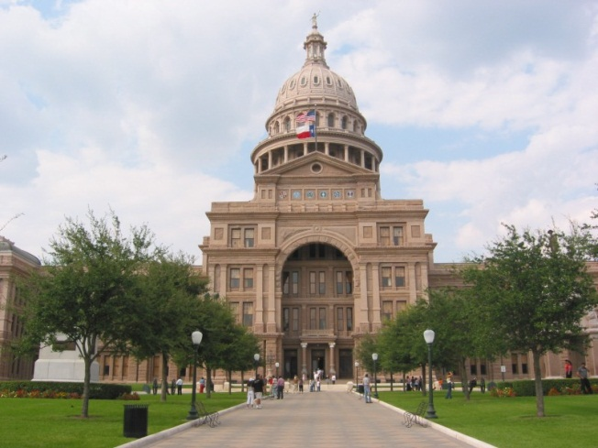
State and Federal Update: Legislative, Policy and Politics
John Hawkins
Texas Hospital Association
John Henderson, CEO
TORCH
October 2024

Slide 2
#1 Concern for Texas Hospitals: Workforce
Pipeline: Increase funding to increase the health care workforce = critical Texas infrastructure.
64% of hospital had reduced services due to staff shortages
15,709 qualified applicants turned away from the state’s nursing schools in 2021, per Texas Center for Nursing Workforce Studies
Funding in HB 1:
Professional Nursing Shortage Reduction Program for Texas nursing school faculty supplements and clinicals = $46.8M biennium (+$27.9M).
Nursing Scholarships = new $25M biennium (tied to SB 25).
Nurse Faculty Loan Repayment Program = $7M biennium (+$4M).
Behavioral Health Loan Repayment Program = $28M (+$26M).
Maintain GME funds for physicians at 1.1 to 1 ratio = $233M (+$34M)
Physician Education Loan Repayment Program = $35.5M (+$6M)
Family Practice Residency Program = $16.5M (+$7M)
Rural Residency Physician Program created with new $3M
Notes:
https://www.hhs.texas.gov/sites/default/files/documents/covid-19-emergency-reporting-sept-2022.pdf

Slide 3
Hospital Funding in the 2023 State Budget
Increased state funding of Medicaid:
All Medicaid funding $12B increase over previous biennium
Trauma, safety net and rural (increased) hospitals add-ons
12 Month Post Partum Medicaid Coverage began March 1
Inpatient Community Psychiatric Beds Increased
$100.1 million over biennium to contract for 170 competency restoration beds
$206.3 million over biennium to maintain existing capacity and 193 additional state purchased beds (70 rural;123 urban)
$13.7 million for beds in Uvalde
Prioritizes 20 beds for DFPS conservatorship.
Total: $306.4 million over biennium allocated to additional beds.
$2 Billion for construction and improvements at State Hospitals

Slide 4
Hospital Funding in the State Budget cont.
Trauma Fund Maintained at $226M over biennium
+ $3.3M AF more for RACS
Rider 37 directs HHSC to report on uncompensated trauma care
Rural Hospital Funding Increases:
Inflation adjustment increase of $213M AF biennium
L&D add-on increased to $1500 from $500 ($47M AF)
$50M for rural financial stabilization grants
$7.4M GR for rural telepsychiatry consultations (HHSC Rider 56)
Definition of “Rural” updated post-census

Slide 5
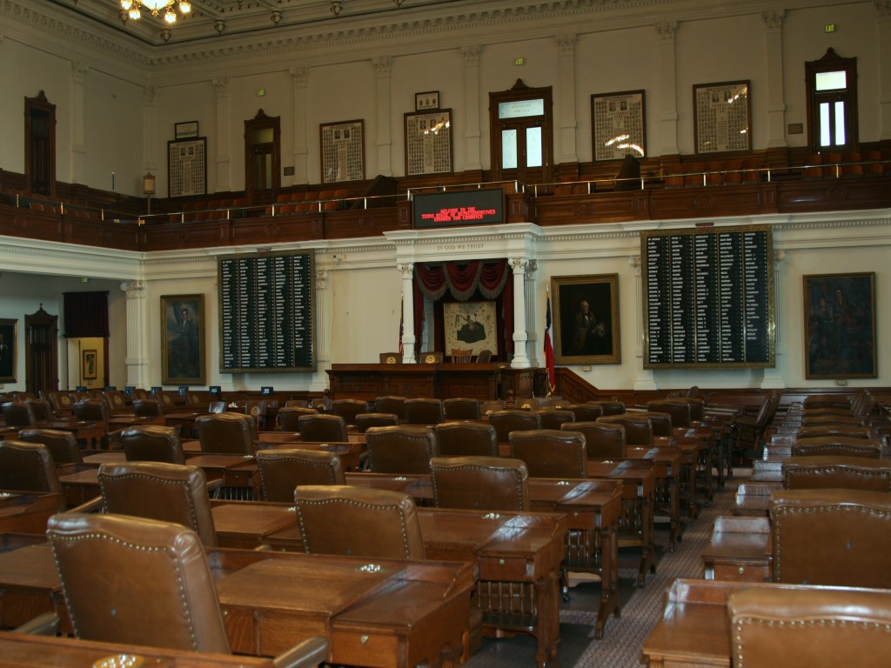
Legislative Challenges Were Significant in 2023
House Select Committee on Health Care, charged with looking at “excessive health care costs”:
Legislation banning all hospital outpayment payments, defined as “facility fees”, died. Health insurance backed bill. (HB 1692 and SB 1275)
Legislation forcing hospitals to accept a government-set rate for services provided outside of insurance, despite charity care requirements, died. The rate would be set at the lowest commercial contracted rate. (HB 633)
Legislation requiring a 10-person legislative committee to establish government-set hospital rates for ERS, TRS, UT and A&M plans died. This would have superseded existing private market negotiations with health plans for one of 11 Texans with private insurance. (HB 5186)
Legislation allowing health insurance companies to sell deregulated insurance-like products free from consumer protections existing in law died. The bill would have created more uncompensated care. (HB 1001)
Legislation to create a health insurance think tank to review all health insurance requirements, putting health insurance companies in the driver’s seat of determining regulations and coverage, died. (HB 2403 / SB 1581)

Slide 6
Legislator Quotes from 2023
State Senator to THA witness: What was the average bonus payment hospitals got for treating a COVID patient?
House Chairman to THA witness: Hospital are completely on par with insurance companies… There are few hospitals that can’t negotiate fairly with an insurance company. Many hospitals are monopolies with an upper hand over insurance companies.
House Chairman from House Floor: Some hospitals are taking advantage of the uninsured and it needs to stop.
House Chairman from House Floor: Medicare is considered above cost at 90% of the hospitals in Texas.
House Chairman in Committee: This bill will take money out of the hospital’s pocket, that’s the point.

Slide 7
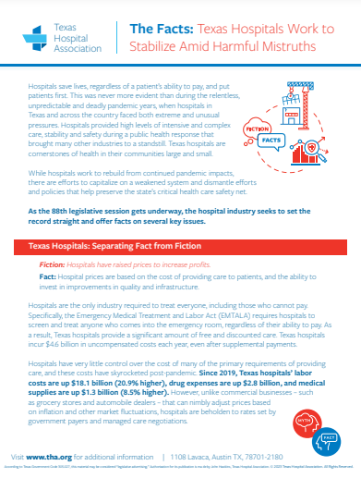
Ongoing Scrutiny of Hospitals
Hospital Charges
Hospital Charity Care Policies, Percentages
Hospital Medicaid Supplemental Payments
Medicare Pays Above Cost of Care
Hospital Compliance with Price Transparency
Facility Fees are Hidden Fees
Site Neutral Payment Push
Hospital Consolidation Drives Up Costs
Patient Billing Confusion
Notes:
Threats to Reimbursements, Interference in Private Contracts, Increased Mandates, Reduced Health Coverage for Texans:

Slide 8
Art. IX Hospital Study Rider in State Budget
In H.B. 1, Article IX the Texas Legislature appropriated to HHSC $5 million to contract with a third party to study and report on hospital finances and utilization. The report, due to the Legislature by December 1, 2024, will include:
Transparency Reporting: Recommendations on ways to improve hospital reporting and transparency, including reducing duplicate reporting requirements.
Hospital Revenue including Supplemental Payment Programs: A summary of all hospital revenue streams and their value, to include public revenue streams.
Charity Care and Community Benefit Compliance: An examination of the value of charity care, bad debt expenses, unreimbursed costs and other community benefit information.
Tax-Exempt Status Values: Information indicating the value of tax-exempt status, including a roster of all “nonprofit medical exempt” properties in the state belonging to hospitals and market and tax data relevant to these properties.
Operating Cost and Financial Assistance Information: A statewide analysis of hospital operating costs, service area characteristics, and financial assistance practices.
Compliance with Charity Care Reporting: An assessment of hospital compliance with required charity care disclosures and notices.

Slide 9
2024: Reframe and Drive the Narrative
Harness the Power of Hospital Leaders in Each Community:
Hospitals in Action in 2024
https://www.tha.org/hospitals-in-action/
THA CEO Checklist sent by email to CEO
“Easy Button” Action Items by Quarter
Legislator Engagement, Tools
THA Providing Template for Legislator Visits
White Papers on Priority Issues for Legislators, Board, Public
Motivated Adversary Engagement
HOSPAC – donate to collectively support HOSPAC-Board endorsed candidates
Interim Studies - Hospital Engagement

Slide 10
Anticipate Challenges
Educate on Hospital Hot Button Issues
Charity Care 2022 – 100% state law compliance
Cost Report Reviews – Worksheet S-10 Reference Guide for Texas Hospitals
State Transparency Compliance – THA outreach to hospitals not in compliance
Respond to HHSC emails!
THA & TNA Workplace Violence Toolkit – Download on THA’s website. In effect on Sept 1, 2025.
https://www.tha.org/wp-content/uploads/2023/12/Workplace-Violence-Toolkit-2023.pdf

Slide 11
Interim Studies: Establishing 2025 Priorities
Study, evaluate, monitor, recommend:
Access to primary and mental care. Could regulatory and licensing flexibilities improve access to care, particularly in medically underserved areas of Texas (Senate HHS).
State health insurance market and alternatives to employer-based insurance. Identify barriers Texans face when navigating a complex health insurance market (Senate HHS).
Children’s mental health care (Senate HHS). Monitor mental health funding and services (Senate Finance).
Workforce shortage funding implementation (Senate HHS).
COVID vaccine employer prohibition. (Senate HHS).
Medicaid managed care oversight and accountability (Senate HHS, House Human).
Reimbursement rates. (House Appropriations).
Emergency detention of a person with mental illness (House Public Health).
Closures of obstetrics units in rural areas and the attendant effects on births and infant and maternal mortality. Make recommendations to facilitate convenient access to prenatal and obstetrical care (House Public Health).
Use and development of AI (Senate B&C / House Special Cmte).

Slide 12
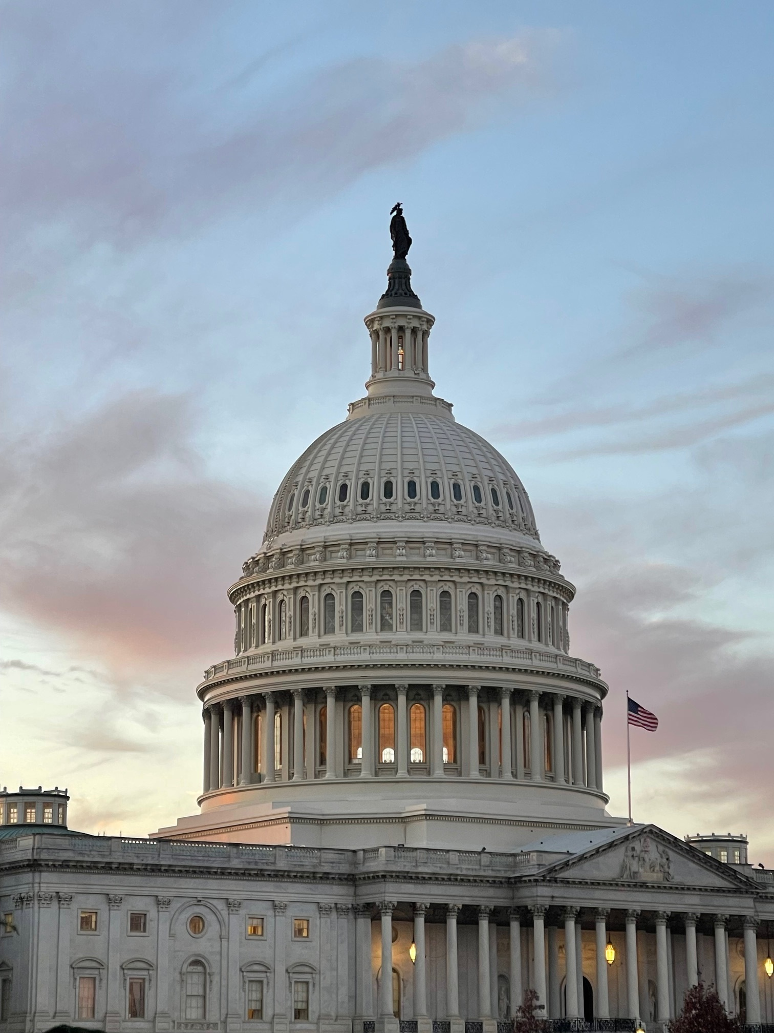
Meanwhile in Washington, D.C.
Hospitals Challenges Persist in DC:
Site Neutral for Drug Administration, Etc.
Increased Penalties, Requirements for Transparency Compliance
Hospital Merger and Acquisition Scrutiny
Charity Care Scrutiny
340B Scrutiny, Proposals to “Contain” Funding
DSH Cuts Delayed To Jan. 1 2025 ($800M)
Medicare Dependent and Low Volume now expire end of year
Telehealth Flexibilities & Hospital at Home expire end of year
CMS Rule on Provider Financed Payments
Effective in 2028, Texas lawsuit injunction in place.

Slide 13
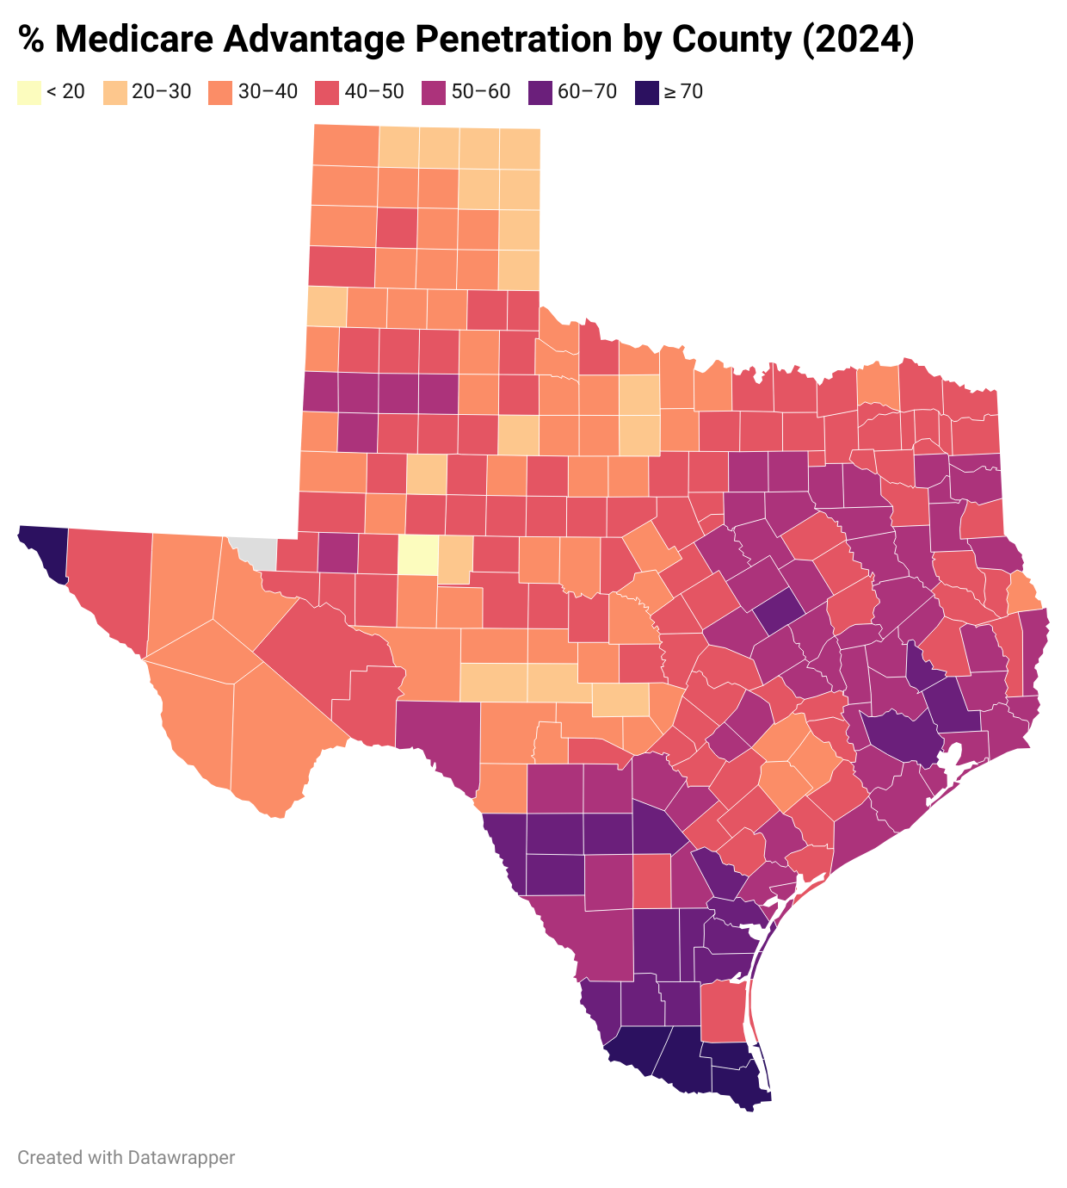
Medicare Advantage
Ongoing Advocacy:
CMS Comment / Response Letters
CY 24 Plan Year (CMS-4201)
Prior Auth and Interoperability (CMS-0057)
Ways & Means Rural RFI
Response to House Budget Committee RFI
Working with Ways & Means members on draft bill to bring CAHs back to cost-based payments
Rules & Reports:
AHA Analyses of MA Plans Defying Rule, AHA Letter
https://www.aha.org/lettercomment/2023-11-20-aha-urges-cms-swiftly-correct-medicare-advantage-plan-policies-appear-violate-cy-2024-rule
CMS Rules on PA, Timing, Advertising
OIG Report on Inappropriate Denials of Services and Payments in MA
Discussion at state level as examples on managed care challenges

Slide 14
Effectively Addressing Cost Drivers
Increase the Texas health care workforce to ensure providers can provide care, staff vacant beds, and balance continued workforce cost challenges;
Ensure nurses and all health care providers are safe at work by developing strong plans to prevent workplace violence, which endangers patients and staff and increases staff turnover and staffing costs;
Improve access to care and increase health care coverage, including post-partum care for mothers and access for inpatient behavioral health patients, which will decrease Texas hospitals’ more than $2 billion in uncompensated care and cost shifting to private insurance;
Increase resources for behavioral health care with increased bed capacity statewide, more BH workforce, and increased access and coverage leading to less hospitalizations;
Balance individual rights and the needs for safety within hospitals, ensuring a strengthened public health system and fewer sick patients.

Slide 15
Impact of Campaigns & Election
March Primary and Resignations = Huge Impact
Paxton Impeachment
Abbott on School Vouchers / School Choice
Party of Committee Chairs
November 5 General Election
Presidential Cabinet?
Lt. Governor Impact
Texas House Speaker
Committee Chairs

Slide 16
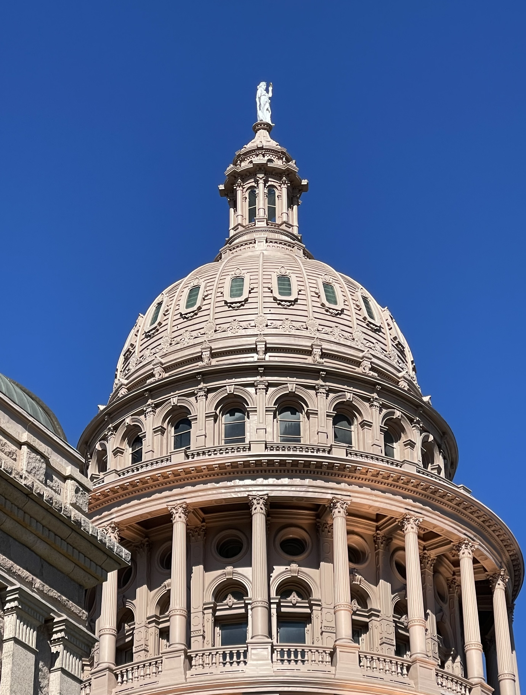
Education and Advocacy Materials:
THA White Papers & Reports:
The Value of Texas Hospitals
Impact of Government Underpayments & Uninsured
EMTALA
Nonprofit Charity Care & Community Benefits
Oppose Facility Fee Cuts
Oppose Site Neutral Payment Cuts
Solutions to Improve the Healthcare Workforce
THA White Papers & Reports - Texas Hospital Association

Slide 17
Register for an Upcoming THA Town Hall
All events will be virtual, register now at tha.org/events-education/townhalls/
Legislative Budget and Session Outlook with Comptroller Glenn Hegar
Oct. 15 from 10-11 a.m. CT
Federal Policy Priorities with U.S. Rep. Lloyd Doggett
Oct. 22 from 2-3 p.m. CT
State Legislative Priorities
TBD

